Slide 1
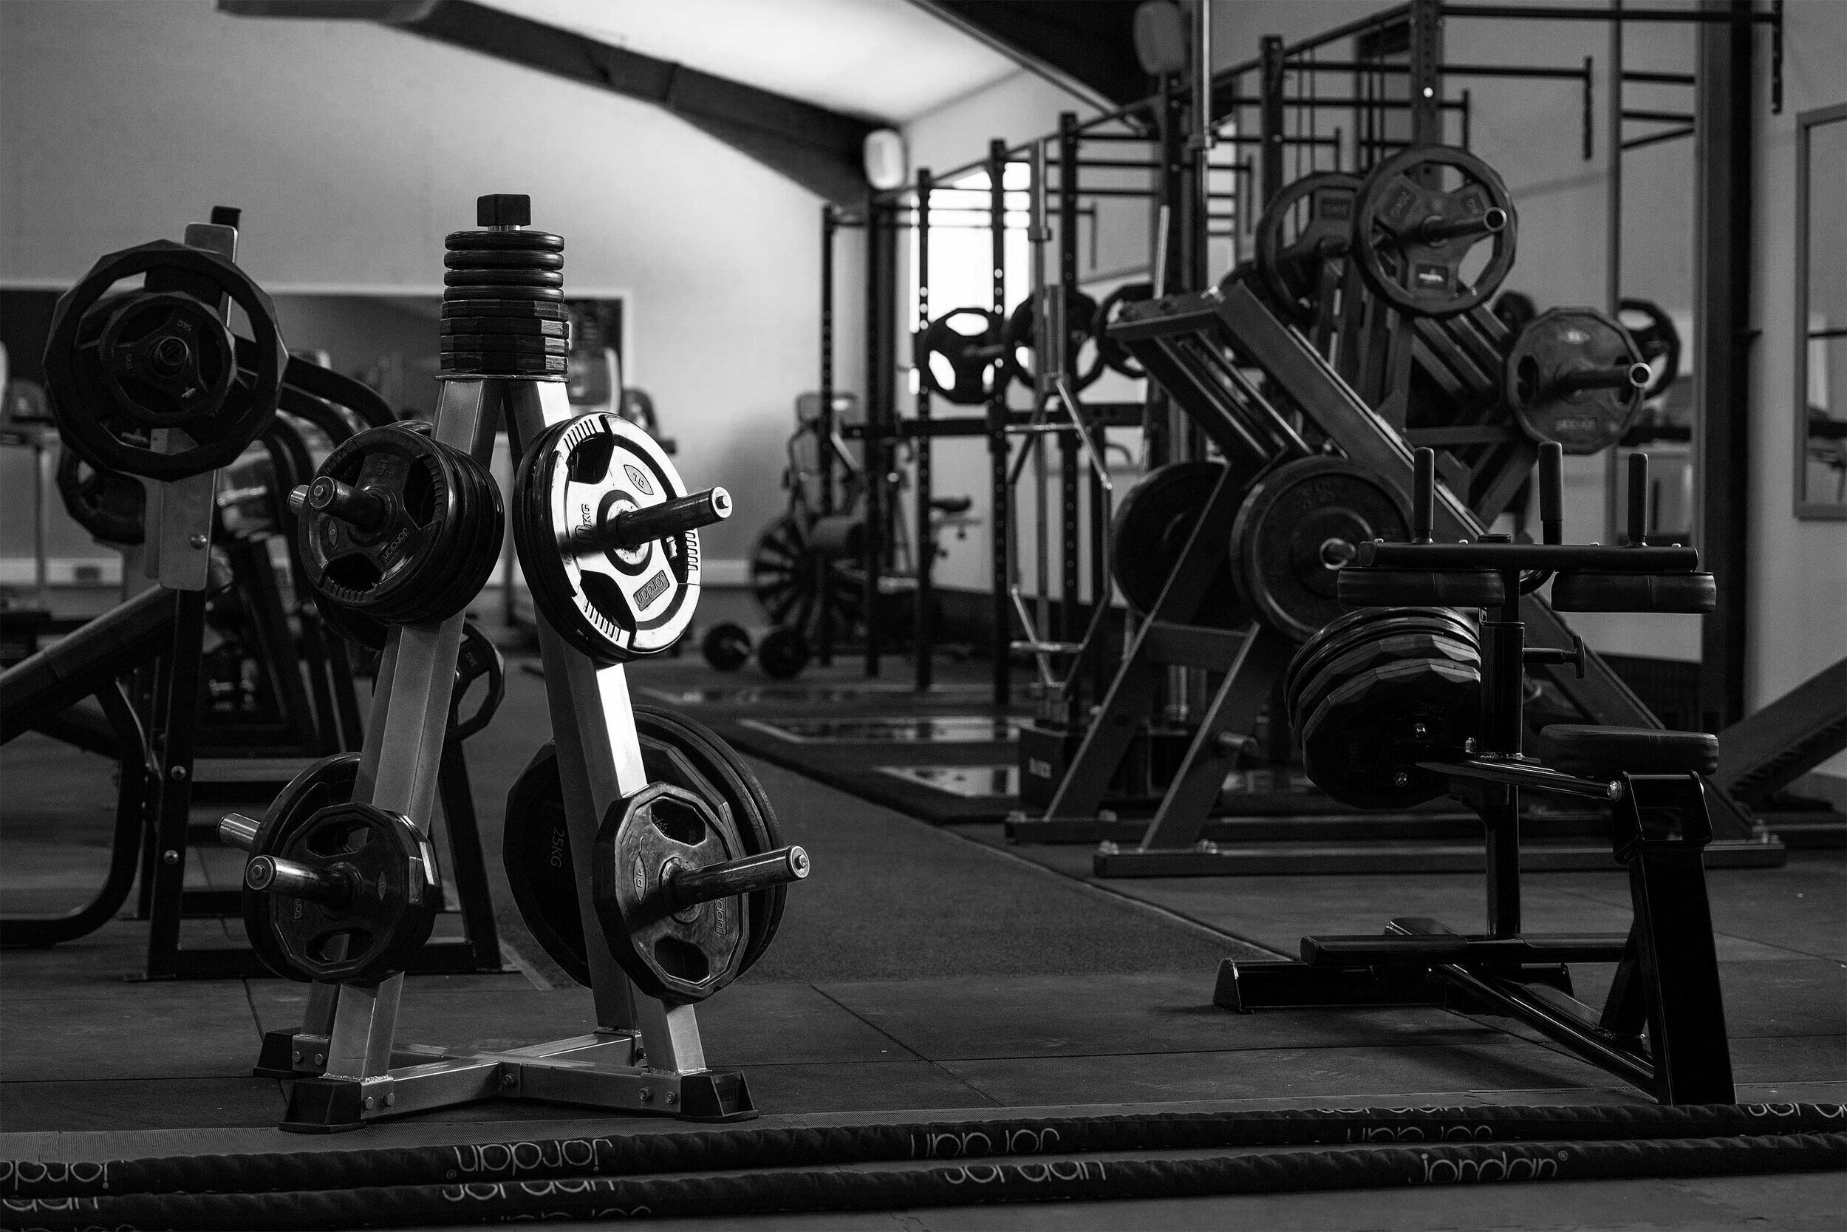
GYM MANAGEMENT SYSTEM
PREPARE BY:-
Dharvi kotak
Simran Tanti
Dharm Bhut
Pruthvi Thummar

Slide 2
Project analysis by Dharvi Kotak
Food ordering
Chat app
Notes app
Fuel Management System

Slide 3
Project analysis by Simran Tanti
Cafe management
Hospital management
Photo editing
Payment app

Slide 4
Project analysis by Pruthvi Thummar
School management
Video creation
Boutique center
Sports center

Slide 5
Project analysis by Dharam Bhut
House rent
E-commerce
Activity center
Travels management

Slide 6
Software Tools & Technologies
Tools:
Technologies:
My SQL Server
Microsoft Office
Visual Studio Code
HTML
CSS
React JS

Slide 7
AIM OF THE PROJECT
To remove the manual or paper work in the Fitness club.
Provide a platform with interactive user interface for both customer and admin.
Save the time of both admin and customer.
Get online Plans in an efficient manner.
To save cost for each user.
User friendly
Weight loss
One of the main aim is healthy living

Slide 8

SWOT Analysis
S
STRENGTHS
Good

Slide 9
PROPOSED SYSTEM
The proposed system is used for stores records of the system.
It is easier to find the user names, workout timings, summery etc.
Time table is orderly arranged. It has implemented an information of about the gym, about fees structure and schedule of workout days and also schedule of daily diet for every members.
Then, the gym was provided a supplement store for viewing what all specialties’ are of workout and diet. Gym admin can maintain the daily attendance and workout summery.
This application will also notify the user (gym members) about their fees and also notifies the gym owner about the payment clearance.

Slide 10
ADVANTAGES OF PROPOSED SYSTEM
The proposed system is highly secured, because for login the system it requires the username and password which is different for each department therefore providing each department a different view of the customer information.
It provides wide range of certain criteria in each window the client is working for better and quicker solution.
It maintains report for all criteria and transactions.
Manages member information separately for all bill information separately for considering the requirement of gym.
Stores information about regular products.
Diet recommendation

Slide 11
MODULE LIST
ADMINISTRATOR
Login
Add Member
Update/Delete Members
Create Bills
Assign Fee Package
Assign Notification for monthly
Report export
Diet Details

Slide 12
MODULE LIST
USER
Login
View Bill Receipts
View bill notification
View diet
View schedule

Slide 13
CONCLUSIONS
The “GYM MANAGEMENT SYSTEM” is successfully designed and developed to fulfilling the necessary requirements, as identified in the requirements analysis phase, such as the system is very much user friendly, form level validation and field level validation are performing very efficiently.
The new computerized system was found to be much faster and reliable and user friendly then the existing system, the system has been designed and developed step by step and tested successfully.
It eliminates the human error that are likely to creep in the kind of working in which a bulk quantity of data and calculations as to be processed.
The system results in quick retrieval of information that is very vital for the progress any organization. Cost is minimized in case of stationary.
Burden of manual work is reduced as whenever transaction takes place, there is a no need to record it in many places manually.

Slide 14


Slide 15


